Slide 1


Data Structures
Lab # 3 Linked List

Slide 2

Linked List
A Linked List is a linear data structure in which elements (called nodes) are stored in memory dynamically and connected with the help of pointers.
Unlike arrays, elements in a linked list are not stored in contiguous memory locations; instead, each node contains:
Data → the actual value to store.
Pointer (next) → the address/reference of the next node.

Slide 3
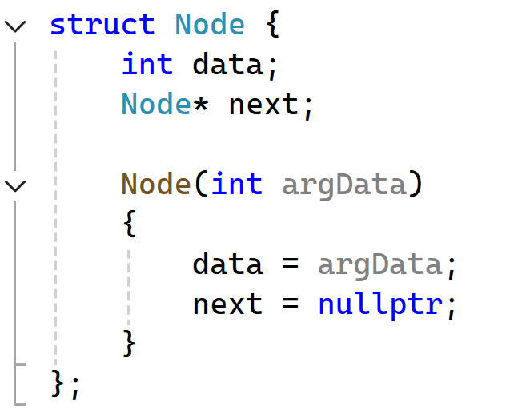
Linked List
The type of data that will be stored in a Node in Linked List
Next pointer is used to Point to the next Node.
Constructor that initialize the members. At this stage next will point to end of the Linked List.

Slide 4
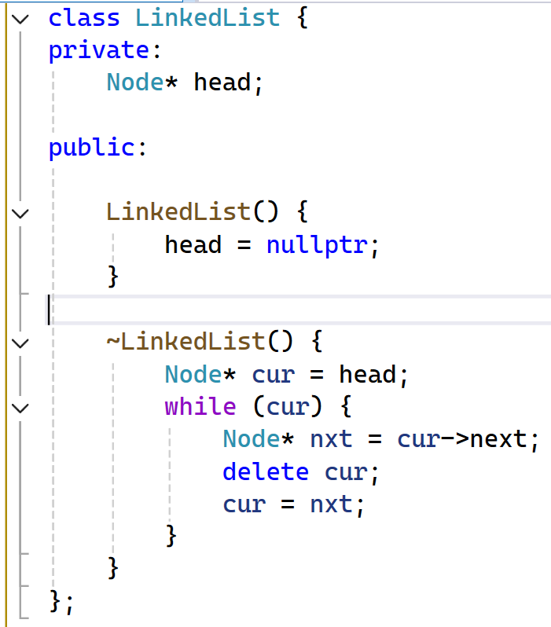
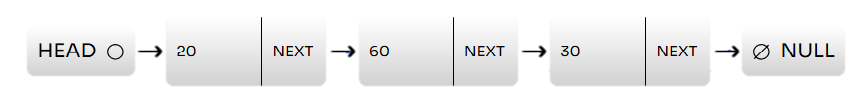
Linked List
Pointer to the Node. Node is user define data type here that we have created earlier.
In the constructor, the head pointer is initialized to nullptr, because initially the linked list is empty and no nodes exist.
In the destructor, we traverse the list and delete each node one by one to free the memory used by the linked list
Notes:
Credit: Linked List Visualizer

Slide 5
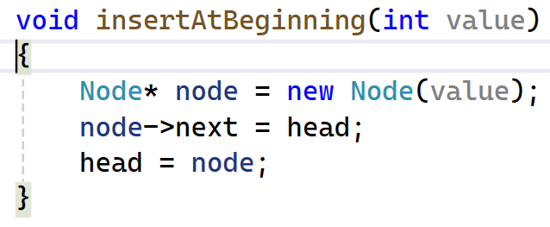
Linked List
Linked List is Empty.
Head
Ø
876
NEXT
Head
20
NEXT
Ø

Slide 6
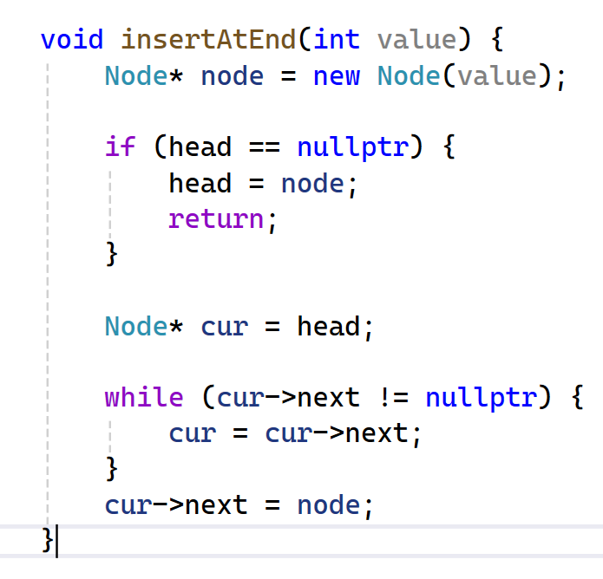
Linked List
Linked List is Empty.
Head
Ø
Head
20
NEXT
Ø
Head
20
NEXT
876
NEXT
Ø
Traverse

Slide 7
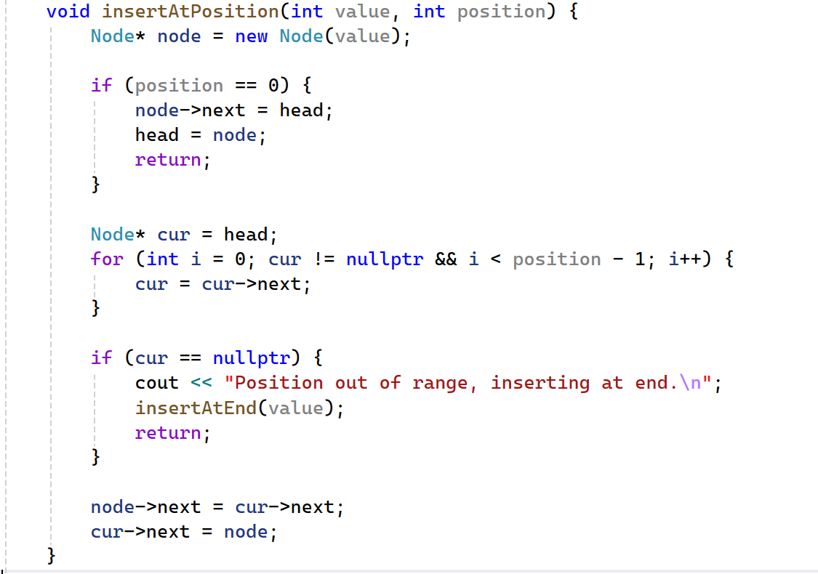
Linked List
Linked List is Empty.
Head
Ø
Head
20
NEXT
Ø

Slide 8
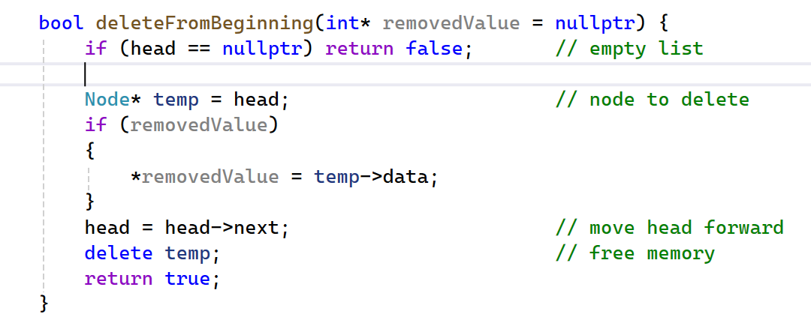
Linked List
Linked List is Empty.
Head
Ø
Head
20
NEXT
Ø

Slide 9

THANK YOU!

